Slide 1
Modsecurity WAF
攻防測試環境

Slide 2






網站攻防實戰環境
攻擊方

Slide 3
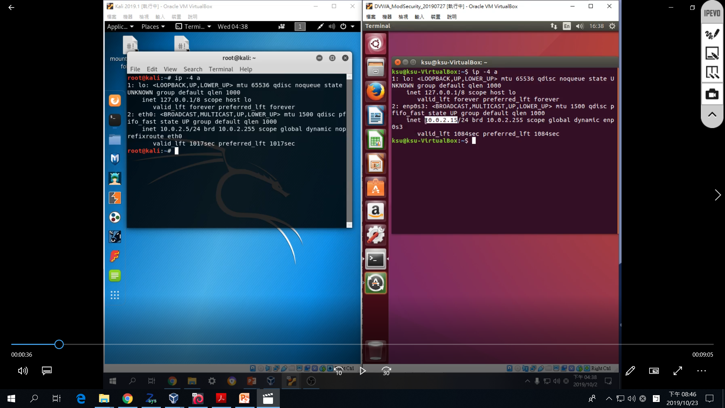
確認IP

Slide 4
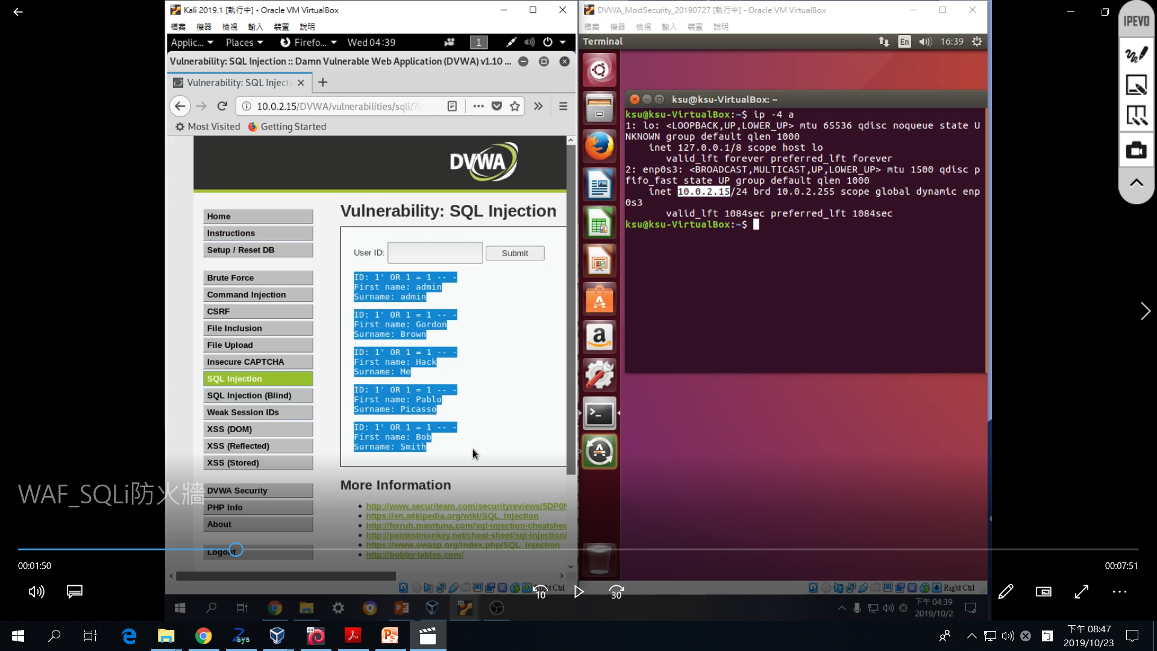

Slide 5
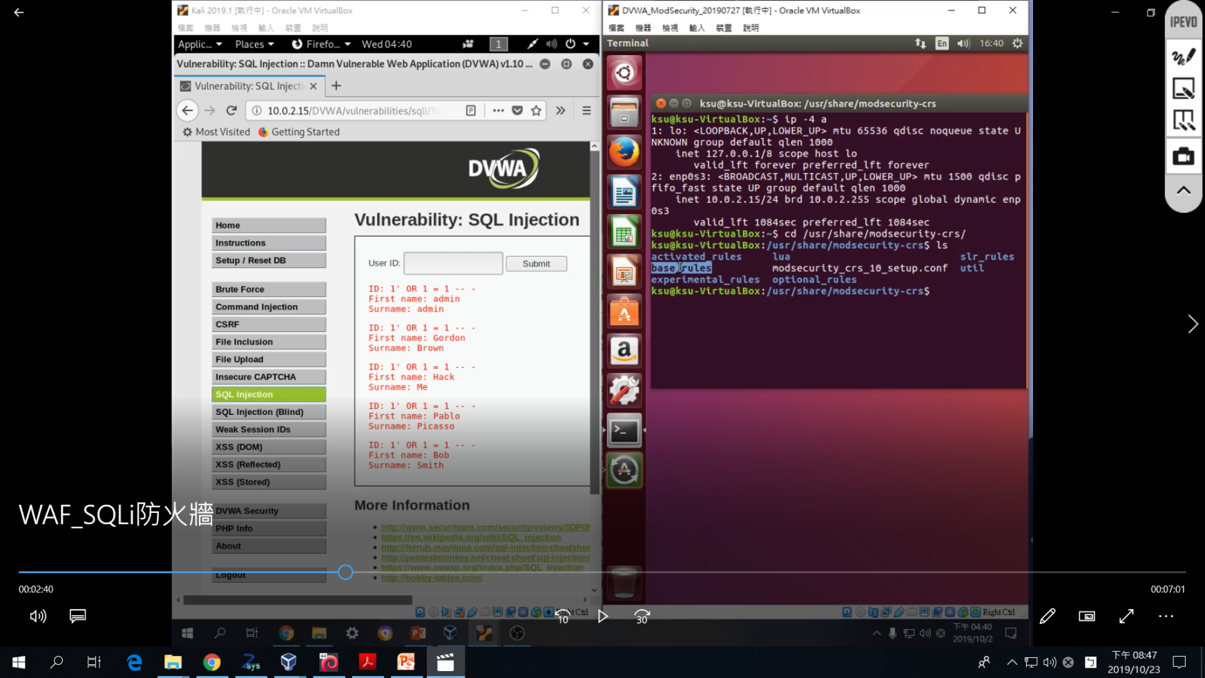

Slide 6
設定ModSecurity規則
sudo cp
/usr/share/modsecurity-crs/base_rules/ modsecurity_crs_41_sql_injection_attacks.conf
/usr/share/modsecurity-crs/activated_rules/
將SQL Injection的規則放入被套用的資料夾

Slide 7
重新啟動apache
sudo service apache2 reload

Slide 8
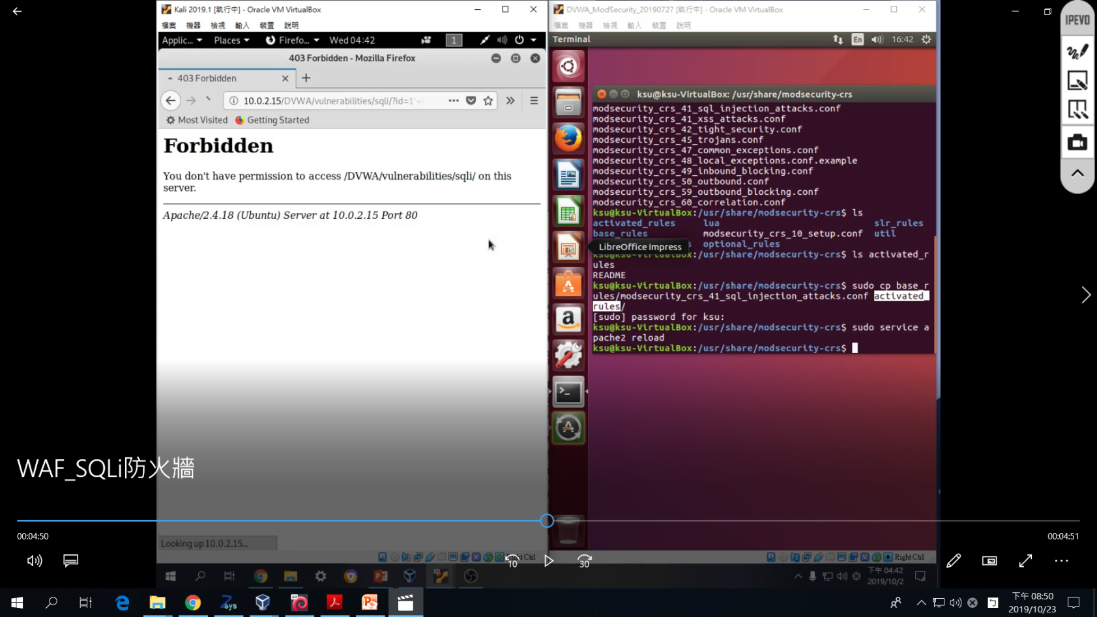

Slide 9
看看日誌檔紀錄

Slide 10
使用modsecurity時, 攻擊被阻擋的狀況
DVWA – SQL Injection
查看ModSecurity log檔:
sudo cat /var/log/apache2/modsec_audit.log

Slide 11
使用modsecurity時, 攻擊被阻擋的狀況
日誌檔紀錄了…
request
連線資訊
(時間、client-server ip port)
--929c8d76-A--
[16/Jul/2019:02:06:53 +0800] XSzAvX8AAQEAAAUc-GgAAAAC 192.168.0.103 35252 192.168.0.103 80
--929c8d76-B--
GET /DVWA/vulnerabilities/sqli/?id=1%27+OR+1+%3D+1+--+-&Submit=Submit HTTP/1.1
Host: 192.168.0.103
User-Agent: Mozilla/5.0 (X11; Ubuntu; Linux x86_64; rv:54.0) Gecko/20100101 Firefox/54.0
Accept: text/html,application/xhtml+xml,application/xml;q=0.9,*/*;q=0.8
Accept-Language: en-US,en;q=0.5
Accept-Encoding: gzip, deflate
Referer: http://192.168.0.103/DVWA/vulnerabilities/sqli/?id=admin&Submit=Submit
Cookie: security=low; PHPSESSID=f5g8op7eorj7d92tmk171krie1; io=vAub6fZUwSDIJeS4AAAA
Connection: keep-alive
Upgrade-Insecure-Requests: 1

Slide 12
DVWA – SQL Injection
日誌檔紀錄了…
response
--929c8d76-F--
HTTP/1.1 403 Forbidden
Content-Length: 314
Keep-Alive: timeout=5, max=99
Connection: Keep-Alive
Content-Type: text/html; charset=iso-8859-1
--929c8d76-E--
<!DOCTYPE HTML PUBLIC "-//IETF//DTD HTML 2.0//EN">
<html><head>
<title>403 Forbidden</title>
</head><body>
<h1>Forbidden</h1>
<p>You don't have permission to access /DVWA/vulnerabilities/sqli/
on this server.<br />
</p>
<hr>
<address>Apache/2.4.18 (Ubuntu) Server at 192.168.0.103 Port 80</address>
</body></html>

Slide 13
DVWA – SQL Injection
日誌檔紀錄了…
違反的規則內容
--929c8d76-H--
Message: Access denied with code 403 (phase 2). Pattern match "(/\\*!?|\\*/|[';]--|--[\\s\\r\\n\\v\\f]|(?:--[^-]*?-)|([^\\-&])#.*?[\\s\\r\\n\\v\\f]|;?\\x00)" at ARGS:id. [file "/usr/share/modsecurity-crs/activated_rules/modsecurity_crs_41_sql_injection_attacks.conf"] [line "49"] [id "981231"] [rev "2"] [msg "SQL Comment Sequence Detected."] [data "Matched Data: -- found within ARGS:id: 1' OR 1 = 1 -- -"] [severity "CRITICAL"] [ver "OWASP_CRS/2.2.9"] [maturity "8"] [accuracy "8"] [tag "OWASP_CRS/WEB_ATTACK/SQL_INJECTION"] [tag "WASCTC/WASC-19"] [tag "OWASP_TOP_10/A1"] [tag "OWASP_AppSensor/CIE1"] [tag "PCI/6.5.2"]
Action: Intercepted (phase 2)
Stopwatch: 1563214013244103 76777 (- - -)
Stopwatch2: 1563214013244103 76777; combined=135, p1=76, p2=57, p3=0, p4=0, p5=2, sr=7, sw=0, l=0, gc=0
Response-Body-Transformed: Dechunked
Producer: ModSecurity for Apache/2.9.0 (http://www.modsecurity.org/); OWASP_CRS/2.2.9.
Server: Apache/2.4.18 (Ubuntu)
Engine-Mode: "ENABLED"

